Slide 1

SMART TRAFFIC MANAGEMENT SYSTEM
Final year Project
on
(2020-2024)
Submitted By :
Submitted to :
MD IFTEAR AHMED (20103089)
NITASH CHUMBER (20103102)
BANOTH ARUN (20103038)
Dr Somesula Manoj Kumar
Assistant Professor, CSE Dept
Dr B R Ambedkar National Institute of Technology Jalandhar (144008), Punjab.

Slide 2
INTRODUCTION
Due to a huge number of vehicles ,very busy road and parking which may not be possible manually as a human being, tends to get fatigued due to monotonous nature of the job and they cannot keep track of the vehicles when there are multiple vehicles are passing in a very short time. So modern cities need to establish effective automatic systems for traffic management and scheduling.
The objective of this project is to design and develop an Automatic traffic light control using google Api, traffic density data using previous data, smart fine system, Car speed and congestion detection and also We can find the lost vehicle using vehicle number plate and find it.

Slide 3
Project Methodology
Increase the efficiency of existing transport infrastructure
Build a smart fine system and in future enhancement automated fine systems for vehicles.
Live Traffic detection system and automated traffic light control system.
Predict the traffic density using machine learning by its previous data.
Automated lost vehicle detection system and information to administration.
Handle traffic congestion using automated light control system.

Slide 4
Our project consists of five main modules :
Automatic traffic light control using live traffic. Show traffic density of particular area for some duration of month in form of graph.
Smart fine system. Thift car identify using car registration number Car Speed and congestion detection
Selling your idea

Slide 5
Problem statement
The rapid urbanization and population growth in modern cities have led to increased traffic congestion, frequent traffic violations, and heightened road safety concerns. Traditional traffic management systems, which rely on fixed timing sequences and manual interventions, are insufficient to handle the dynamic nature of urban traffic. This inadequacy results in significant delays, increased pollution, and higher rates of accidents. To address these challenges, there is a need for an advanced, intelligent traffic management system that can automatically adjust traffic signals based on real-time traffic data, visualize traffic density, recognize license plates, enforce traffic rules through automated fines, and detect vehicle speed and congestion

Slide 6
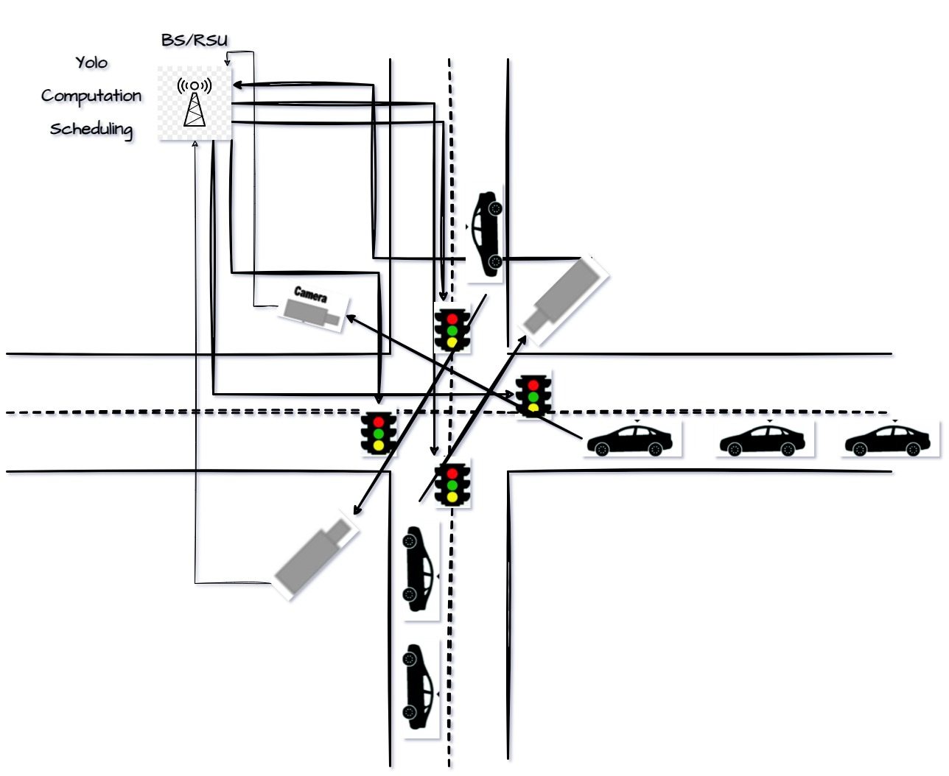
Proposed Solution
live traffic can get from CCTv (Closed Circuit Television Camera) or sensor. There will be cc cameras in around the road, camera send the real time data to the local edge, and local edge will calculate which road’s vehicle should going fast even which road’s light will be green or red even if there are any emergency vehicle like ambulance, fire service at that time that will also be free according to priority scheduling algorithm, this algorithm will work on the edge and decide which road has high priority and then that road should be open. That will be complete according to priority scheduling algorithm. This process is assigned a priority, often represented as a numerical value. Lower numerical values usually indicate higher priority.

Slide 7
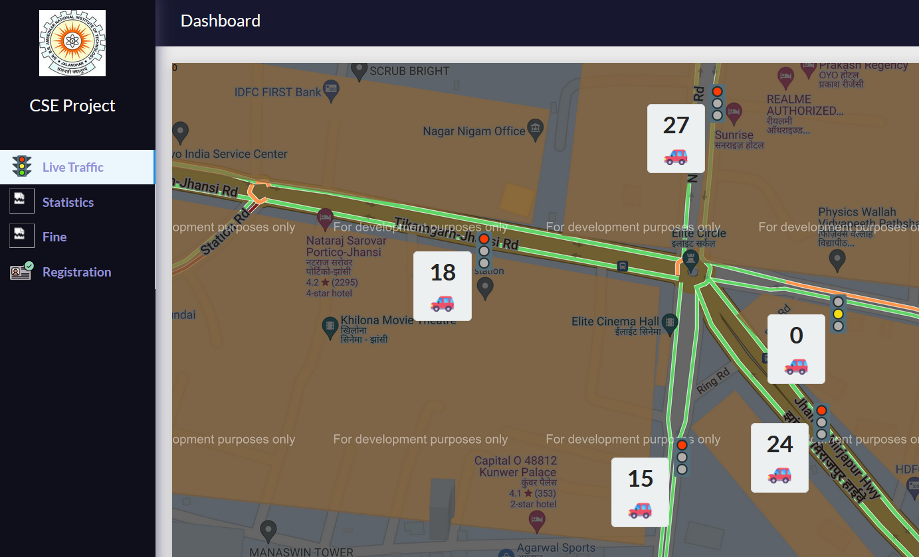
Automatic traffic light control

Slide 8
Traffic light control using live traffic data.
We are taking the live traffic density data from google map Api by giving the longitude and latitude position and google map api give the current location traffic data.
We can improve the live traffic data by using the cctv camera at traffic light.
After getting the number of vehicle at 3/4/ 5 ways crossing ,we can decide which side should be green signal according the traffic count and timestamp and this algorithm is like priority scheduling algorithm and we add timestamp for save from ageing condition.
So by using the above algorithm we can make the automatic traffic light control system.

Slide 9
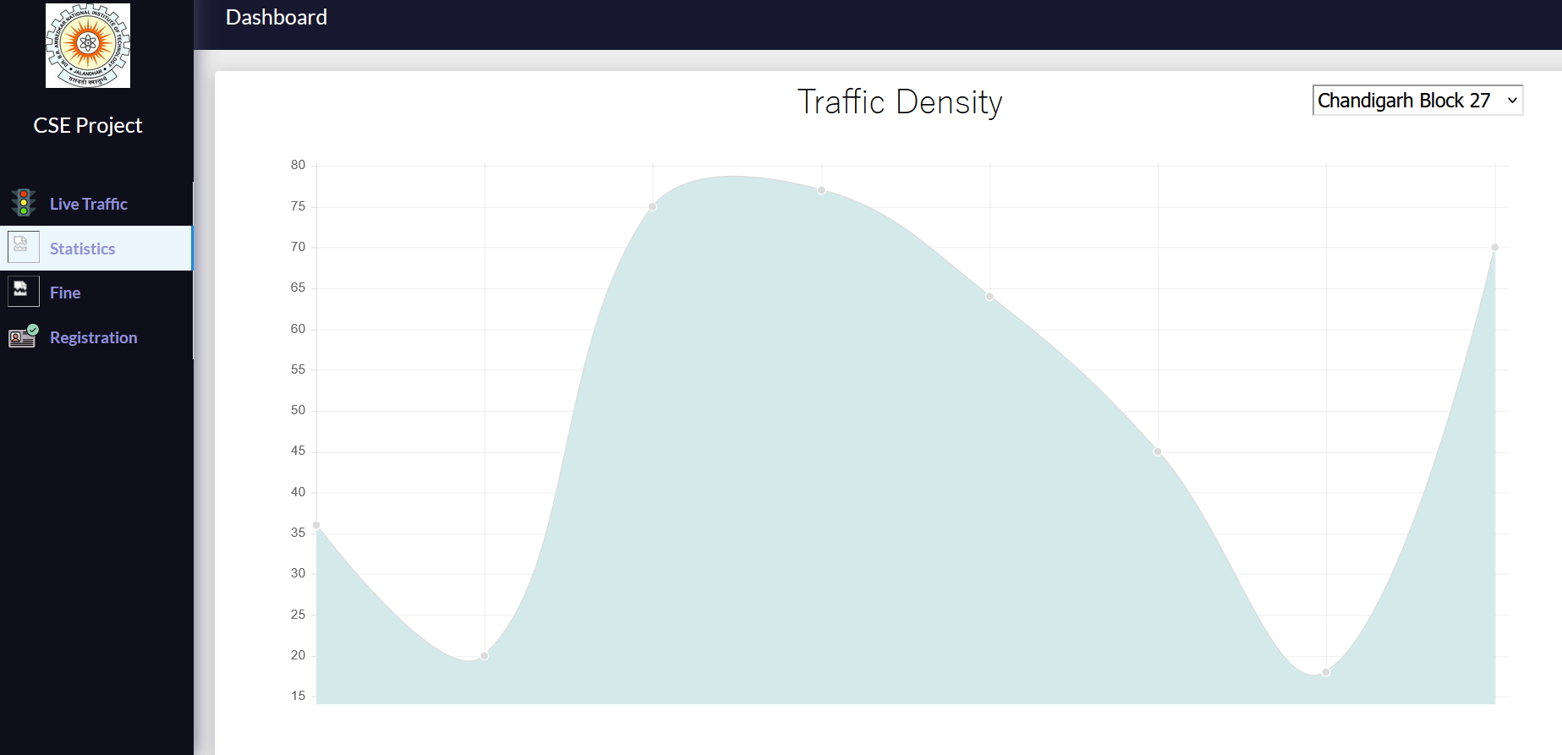
TRAFFIC DENSITY GRAPH

Slide 10
Traffic density of particular area in graph form.
In this we are showing the traffic density of some particular area in month wise and it will help us to predict the next day, month the traffic of those area.
Using the traffic density we can get the knowledge that in which time the traffic is higher. Using this data government would take the decision of road widening in some particular area to reduce the traffic congestion.

Slide 11
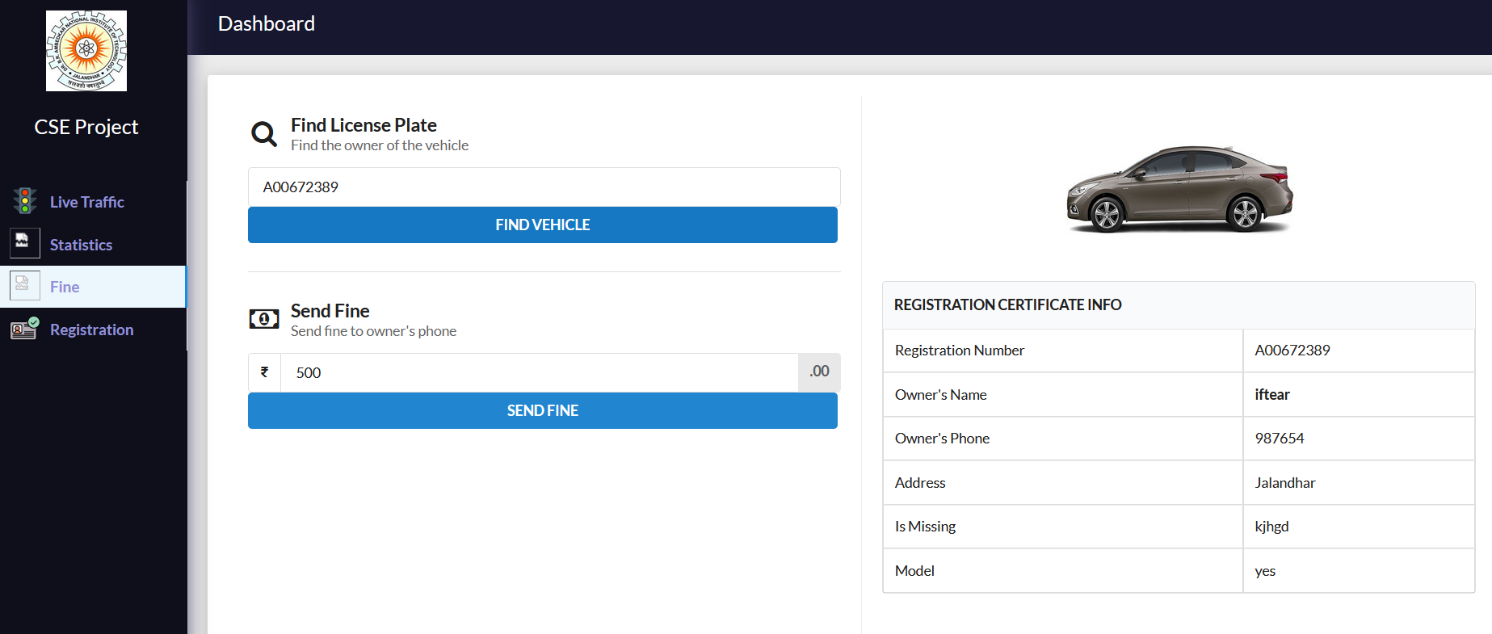
Smart fine system for breaking traffic rules.

Slide 12
Smart fine system
This is a online fine system ,in which administration has to only fill the valid license number of vehicle and it will check vehicle number in our database and if data this vehicle is present in our database then it will show the detail of vehicle owner. We can find also stolen vehicle using mathing registration number
And then admin can send the fine to the user.

Slide 13
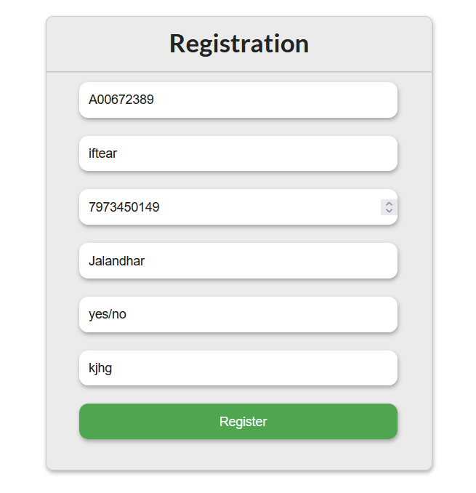
Online Vehicle license registration.
This is a registration form for new vehicle or stolen and in this form all field is mandatory ,mean use have to fill all the field.
It will take the correct format of vehicle number and if user filled invalid vehicle number then it will not accept.

Slide 14
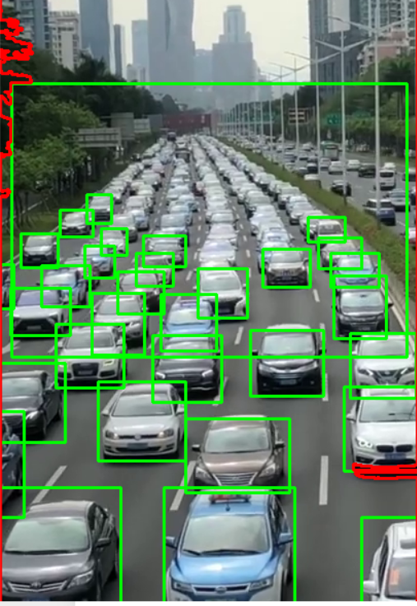
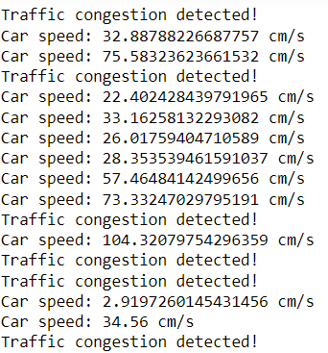
Car speed and congestion detection In this slide, first of all we have detected object and than we have detected car speed and congestion detection using Open-CV library and YOLO (You Only Look Once) is a popular object detection algorithm that can detect multiple objects in an image simultaneously. It is known for its speed and accuracy, making it widely used in various applications such as autonomous driving, surveillance, and image understanding.

Slide 15
Flow Chart
start
Collect live traffic data from cameras and sensors
traffic density in a particular area
Visualize traffic density data
Implement automatic traffic light control
Implement smart fine system
Implement car speed and congestion detection
Read traffic density data
Determine optimal traffic light timing
Monitor vehicle speed & Analyze traffic flow
Filter and aggregate traffic data
Calculate traffic density
Identify congestion & Provide real-time updates
Store traffic density data
Detect traffic violations & Identify vehicles using car registration number
Check vehicle registration details & Issue fines automatically

Slide 16
Literature Survey
Automatic Traffic Light Management Using Live Traffic Data: The use of live traffic data for managing traffic lights has been extensively studied. Younis et al. (2014) discuss adaptive traffic control systems that adjust signal timings based on realtime traffic conditions, resulting in significant reductions in congestion and travel time. Similarly, Liu et al. (2017) propose a dynamic traffic signal control system utilizing vehicular ad hoc networks (VANETs) to collect and analyze traffic data. Their results demonstrate improved traffic flow and reduced waiting times at intersections.
Traffic Density Visualization: Visualizing traffic density helps in understanding and managing traffic patterns. Jenelius and Kotsiopoulos (2013) explore methods for estimating and visualizing urban traffic congestion using data from GPS-equipped vehicles. Their approach provides real-time traffic density maps that can be used for strategic traffic management. Barthélemy et al. (2019) present a comprehensive analysis of urban traffic using network theory, emphasizing the importance of visual tools in identifying congestion hotspots.

Slide 17
Literature Survey
License Plate Recognition and Database Matching: License plate recognition (LPR) technology is a key component in modern traffic management systems. Du et al. (2012) review various LPR techniques, highlighting the advancements in optical character recognition (OCR) and machine learning that have significantly improved accuracy and speed. Additionally, Chen et al. (2014) discusses the integration of LPR systems with central databases for real-time vehicle monitoring and law enforcement, showing its effectiveness in tracking stolen vehicles and enforcing traffic regulations.
Smart Fine System for Traffic Violations: Automated enforcement of traffic laws through smart fine systems has gained traction in recent years. A study by Tao et al. (2015) investigates the implementation of an intelligent traffic violation detection and fine system using video analytics and LPR. Their system successfully identifies violations such as speeding and red-light running, automatically issuing fines to offenders. The study emphasizes the potential of such systems in enhancing road safety and ensuring compliance with traffic laws

Slide 18
Technology Used
JavaScript:
JavaScript is a programming language that conforms to the ECMAScript.JavaScript is high-level, often just-in-time compiled, and multi-paradigm. It has curly-bracket syntax, dynamic typing, prototype-based object-orientation, and first-class functions.
Alongside HTML and CSS, JavaScript is one of the core technologies of the World Wide Web.
React:
React is an open-source JavaScript library for building user interfaces or UI components. It is maintained by Facebook and a community of individual developers and companies.React can be used as a base in the development of single-page or mobile applications.
Python:
Python is an interpreted, high-level, general-purpose programming language. Created by Guido van Rossum and first released in 1991, Python's design philosophy emphasizes code readability with its notable use of significant whitespace. Its language constructs and object-oriented approach aim to help programmers write clear, logical code for small and large-scale projects.

Slide 19
Technology used
YOLO:
The YOLO (You Only Look Once) algorithm is a state-of-the-art object detection algorithm that revolutionized real-time object detection tasks. YOLO approaches object detection as a single regression problem, directly predicting bounding boxes and class probabilities from full images in one evaluation. This allows YOLO to achieve high detection accuracy while maintaining real-time performance.
Cv2 :
refers to the OpenCV library in Python. OpenCV (Open Source Computer Vision Library) is an open-source computer vision and machine learning software library. The cv2 module is the Python interface to OpenCV, providing functions and classes for various computer vision tasks, including image and video processing, object detection, feature extraction, camera calibration, and machine learning.

Slide 20
Applications
Anti-Theft/ Vehicle detection.
Traffic light automation ,no requirement of Traffic police.
Smart fine /E Challan Systems.
Car Parking / Automatic Toll Deduction.
Law Enforcement
VIP/Ambulance path Clearance
Help the government to take the decision of road widening and road construction according to traffic density data.

Slide 21
FUTURE ENHANCEMENT
● Build up a new image acquisition system with better focus and illumination
Use our real time data at place of google api traffic data and Implement the camera at traffic lights using IOT and get better real time data.
Implement better traffic light control using our real time data from camera.
Enhance the stolen vehicle by using gps and image processing technology.
Predict more better traffic density of the area using previous data and create a better prediction model.

Slide 22
CONCLUSION
Summarize the key findings of our project, highlighting its significance, contributions, and potential impact on traffic management and safety. Reflect on the lessons learned and the value of the project in addressing real-world challenges.
A simple effort has been made in this work to develop Automatic traffic light control using google Api live traffic density data, smart fine system, car speed detection, and also We can identify the lost vehicle using vehicle number plate.
We have used Python for machine learning and optical character recognition with mongodb database to obtain the desired results.

Slide 23
REFERENCES
1. Smart Traffic Monitoring System Using Computer Vision and Edge Computing by Guanxiong Liu, Student Member, IEEE, Hang Shi , Abbas Kiani, Student Member, IEEE, Abdallah Khreishah , Senior Member, IEEE, Joyoung Lee , Nirwan Ansari , Fellow, IEEE, Chengjun Liu, and Mustafa Mohammad Yousef
2. Artificial Intelligence-Empowered Logistic Traffic Management System Using Empirical Intelligent XGBoost Technique in Vehicular Edge Networks Monagi H. Alkinani, Abdulwahab Ali Almagro, Mainak Adhikari, Member, IEEE, and Varun G. Menon, Senior Member, IEEE.
3. Automatic License Plate Recognition Using Optical Character Recognition by U Salimah, V Maharani and R Nursyanti Faculty of Technology and Informatics, Indonesian University of Informatics and Business, Soekarno-Hatta Street no. 643, Bandung, Jawa Barat, Indonesia 40285.
4. Intelligent Traffic Violation Detection Roopa Ravish, Dept. of CSE, PES University, Bengaluru, India
Shanta Rangaswamy, Dept of CSE, Rashtreeya Vidyalaya College of Engineering Bengaluru, IndiaKausthub Char, Dept. of CSE, PES University, Bengaluru, India
5. Online resources (W3 Schools, Geek for geeks)

Slide 24


